Slide 1
FAKE NEWS DETECTION
BY-
SUMIT KUMAR 2020466254 SUPERVISOR: ANUSHKA 2020001783 MS.NIKITA VERMA RIYA 2020439863
SHARDA UNIVERSITY
DEPARTMENT OF COMPUTER SCIENCE & APPLICATION
SCHOOL OF ENGINEERING AND TECHNOLOGY
01 SEPTEMBER 2022

Slide 2
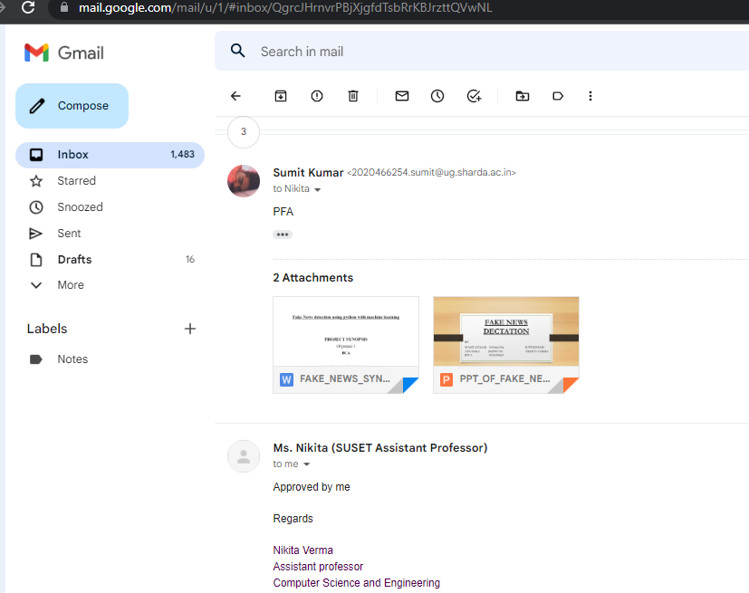
APPROVAL FROM GUIDE FOR EVOLUTION

Slide 3
CONTENTS
ABSTRACT
EXISTING FILE SYSTEM
INTRODUCTION
REQUIRES SOFTWARE
REQUIRES HARDWARE
METHODOLOGY
SYSTEM DESIGN
SYSTEM ARCHITECTURE
IMPLEMNTATION STEPS
REFRENCESSS

Slide 4
ABSTRACT
Intentionally deceptive content presented under the guise of legitimate journalism is worldwide information accuracy and integrity problem that affects opinion forming .decision forming, decision making, and voting patterns . Most so-called ‘fake news is initially distributed over social media conduct like Facebook and Twitter . The fake news stories that are initially seeded over social media platform share key linguistics characteristics such as making excise use of unsustain hyperbole and unattributed quoted content. Fake news has been incurring many problems to our society.

Slide 5
EXISTING SYSTEM
Fake news is the deliberate spread of misinformation via traditional news media or via social media.
How to enforce user privacy preferences..
How to secure data when storage into the PDS.
Users are not skilled enough to understand their privacy.
People can download articles from sites, share the information, re-share from others and by the end of the day the false information has gone so far from its original site that it becomes indistinguishable from real news

Slide 6
INTRODUCTION
We consume news through several mediums throughout the day in our daily routine, but sometimes it becomes difficult to decide which one is fake and which one is authentic.Do you trust all the news you consume from online media?very news that we consume is not real. If you listen to fake news it means you are collecting the wrong information from the world which can absect society because a person’s views or thoughts can change after consuming fake news which the user perceives to be true. Since all the news we encounter in our day-to-day life is not authentic, how do we categorize if the news is fake or real ?

Slide 7
What exactly is ‘FAKE NEWS’ ?
False, often sensational, information disseminated under the guise of news reporting.
Fake news often has the aim of damaging the reputation of a person or entity , or making money through advertising revenue.
False information is news , stories or hoaxes created to deliberately misinform decive readers.
Usually, these stories are created to either influence people’s views, push a political agenda or cause confusion and can often be a profitable business for online publishers.

Slide 8
REQUIRES SOFTWARE
Operating system :-Window 10
Database :-MS SQL
Coding language :-Python
Python libraries :-Numpay, Pandas, Matplotlib

Slide 9
REQUIRES HARDWARE
Processor: 1GHz or faster or SOC.
RAM :1 GB for 32bit or 4 GB of 64bit OS.
Hard disk : 16 GB for 32bit or 32 GB for 64bit OS.
Graphics card : direct 9 or later with WDDM 1.0 driver

Slide 10
Methodology
This paper explains the system which is developed in three parts. The first part is static which works on machine learning classifier.
We studied and trained the model with 4 different classifiers and chose the best classifier for final execution. The second part is dynamic
which takes the keyword/text from user and searches online for the truth probability of the news. The third part provides the authenticity
of the URL input by user.
In this paper, we have used Python and its Sci-kit libraries [14]. Python has a huge set of libraries and extensions, which can be easily
used in Machine Learning. Sci-Kit Learn library is the best source for machine learning algorithms where nearly all types of machine
learning algorithms are readily available for Python, thus easy and quick evaluation of ML algorithms is possible. We have used Django
for the web based deployment of the model, provides client side implementation using HTML, CSS and Javascript. We have also used
Beautiful Soup (bs4), requests for online scrapping

Slide 11
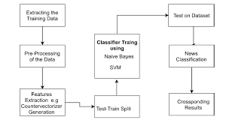
. System Design-

Slide 12
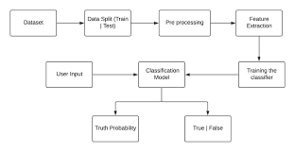
System Architecture-
i) Static Search-
The architecture of Static part of fake news detection system is quite simple and is done keeping in mind the basic machine learning
process flow. The system design is shown below and self- explanatory. The main processes in the design are-

Slide 13
ii) Dynamic Search-
The second search field of the site asks for specific keywords to be searched on the net upon which it provides a suitable output for the
percentage probability of that term actually being present in an article or a similar article with those keyword references in it.
iii) URL Search-
The third search field of the site accepts a specific website domain name upon which the implementation looks for the site in our true sites
database or the blacklisted sites database. The true sites database holds the domain names which regularly provide proper and authentic
news and vice versa. If the site isn’t found in either of the databases then the implementation doesn’t classify the domain i t simply states
that the news aggregator does not exist

Slide 14
IMPLEMENTATION STEPS
A. Static Search Implementation-
In static part, we have trained and used 3 out of 4 algorithms for classification. They are Naïve Bayes, Random Forest and Logistic
Regression.
Step 1: In first step, we have extracted features from the already pre-processed dataset. These features are; Bag-of-words, Tf-Idf Features
and N-grams.
Step 2: Here, we have built all the classifiers for predicting the fake news detection. The extracted features are fed into different
classifiers. We have used Naive-bayes, Logistic Regression, and Random forest classifiers from sklearn. Each of the extracted features

Slide 15
was used in all of the classifiers.
Step 3: Once fitting the model, we compared the f1 score and checked the confusion matrix.
Step 4: After fitting all the classifiers, 2 best performing models were selected as candidate models for fake news classification.
Step 5: We have performed parameter tuning by implementing GridSearchCV methods on these candidate models and chosen best
performing parameters for these classifier.
Step 6: Finally selected model was used for fake news detection with the probability of truth.
Step 7: Our finally selected and best performing classifier was Logistic Regression which was then saved on disk. It will be used to
classify the fake news.

Slide 16
REFERENCES
[1] Kai Shu, Amy Sliva, Suhang Wang, Jiliang Tang, and Huan Liu, “Fake News Detection on Social Media: A Data Mining Perspective”
arXiv:1708.01967v3 [cs.SI], 3 Sep 2017
[2] Kai Shu, Amy Sliva, Suhang Wang, Jiliang Tang, and Huan Liu, “Fake News Detection on Social Media: A Data Mining Perspective”
arXiv:1708.01967v3 [cs.SI], 3 Sep 2017
[3] M. Granik and V. Mesyura, "Fake news detection using naive Bayes classifier," 2017 IEEE First Ukraine Conference on Electrical
and Computer Engineering (UKRCON), Kiev, 2017, pp. 900-903.
[4] Fake news websites. (n.d.) Wikipedia. [Online]. Available: https://en.wikipedia.org/wiki/Fake_news_website. Accessed Feb. 6, 2017
[5] Cade Metz. (2016, Dec. 16). The bittersweet sweepstakes to build an AI that destroys fake news.
[6] Conroy, N., Rubin, V. and Chen, Y. (2015). “Automatic deception detection: Methods for finding fake news” at Proceedings of the
Association for Information Science and Technology, 52(1), pp.1-4.
[7] Markines, B., Cattuto, C., & Menczer, F. (2009, April). “Social spam detection”. In Proceedings of the 5th International Workshop on
Adversarial Information Retrieval on the Web (pp. 41-48)

Slide 17
THANK YOU

